Slide 1
Layout 0818
By Ricky 08/13

Slide 2
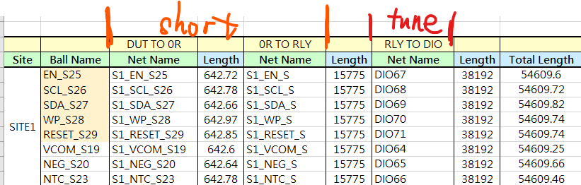
Scan chain
Scan chain eqlength is total length equal, but not segment equal
Keep the S*_XXX_S*& S*_XXX_S as short as possible
, then tune the eqlength by DIO segment to feet total length equal

Slide 3
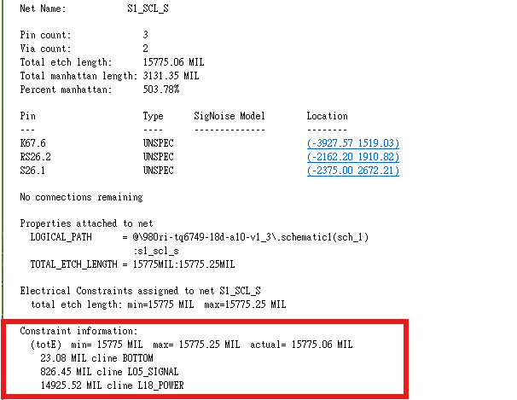

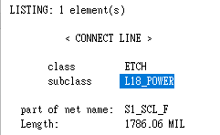
scan chain/ scan chain force should trace on GPG layer，can't trace on GPPG layer
can't use L11,12/14,15/17,18/

Slide 4
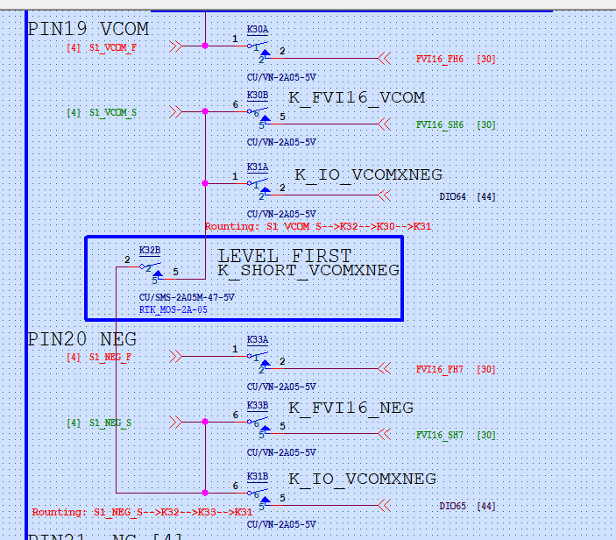
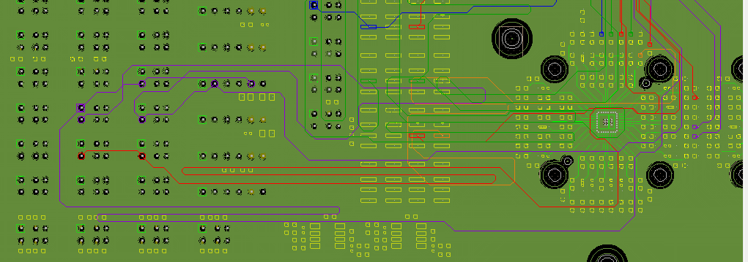
route of VCOM/NEG is reversed ,K31 should be the goal (purple trace)
When you tune the routing followed page 2，this question should be solved naturally

Slide 5
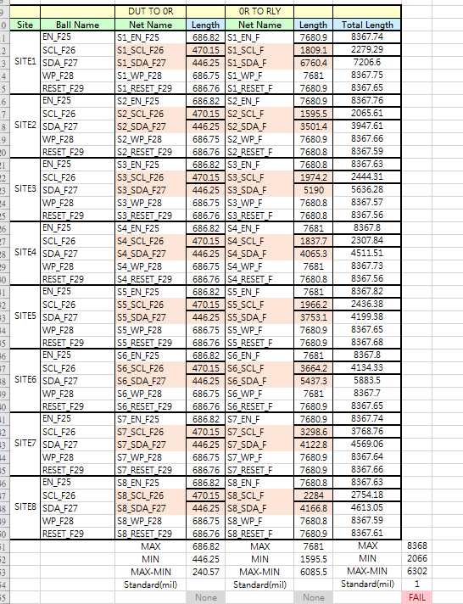
Scan chain force
Orange net are naming miss,please fix the length

Slide 6
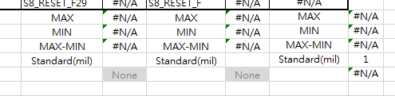
same question as scan cain(Y1 )
only need to meet the total length equal requirement, and please let this length as short as possible

Slide 7
TMU/TMU other
Checked, no problem

Slide 8
Please upload the trace width file (with Data)
So I can accord the file to check the width of trace, thx

